Slide 1
Surface Hub 2S Whiteboard Guide

Slide 2
Table of contents
Whiteboard toolbar – Ink, Highlight, Erase, Ruler, Lasso, Insert, Undo, Redo
Work with images – Insert, Move, Resize, Cut, Copy, Stack
Whiteboard menu – Ink to Shape, Ink to Table, Background
Sign in to save and share – Sign in with Office 365
Export a whiteboard – Send Whiteboard as email attachment

Slide 3
<- Back to Table of Contents

Slide 4
<- Back to Table of Contents

Slide 5
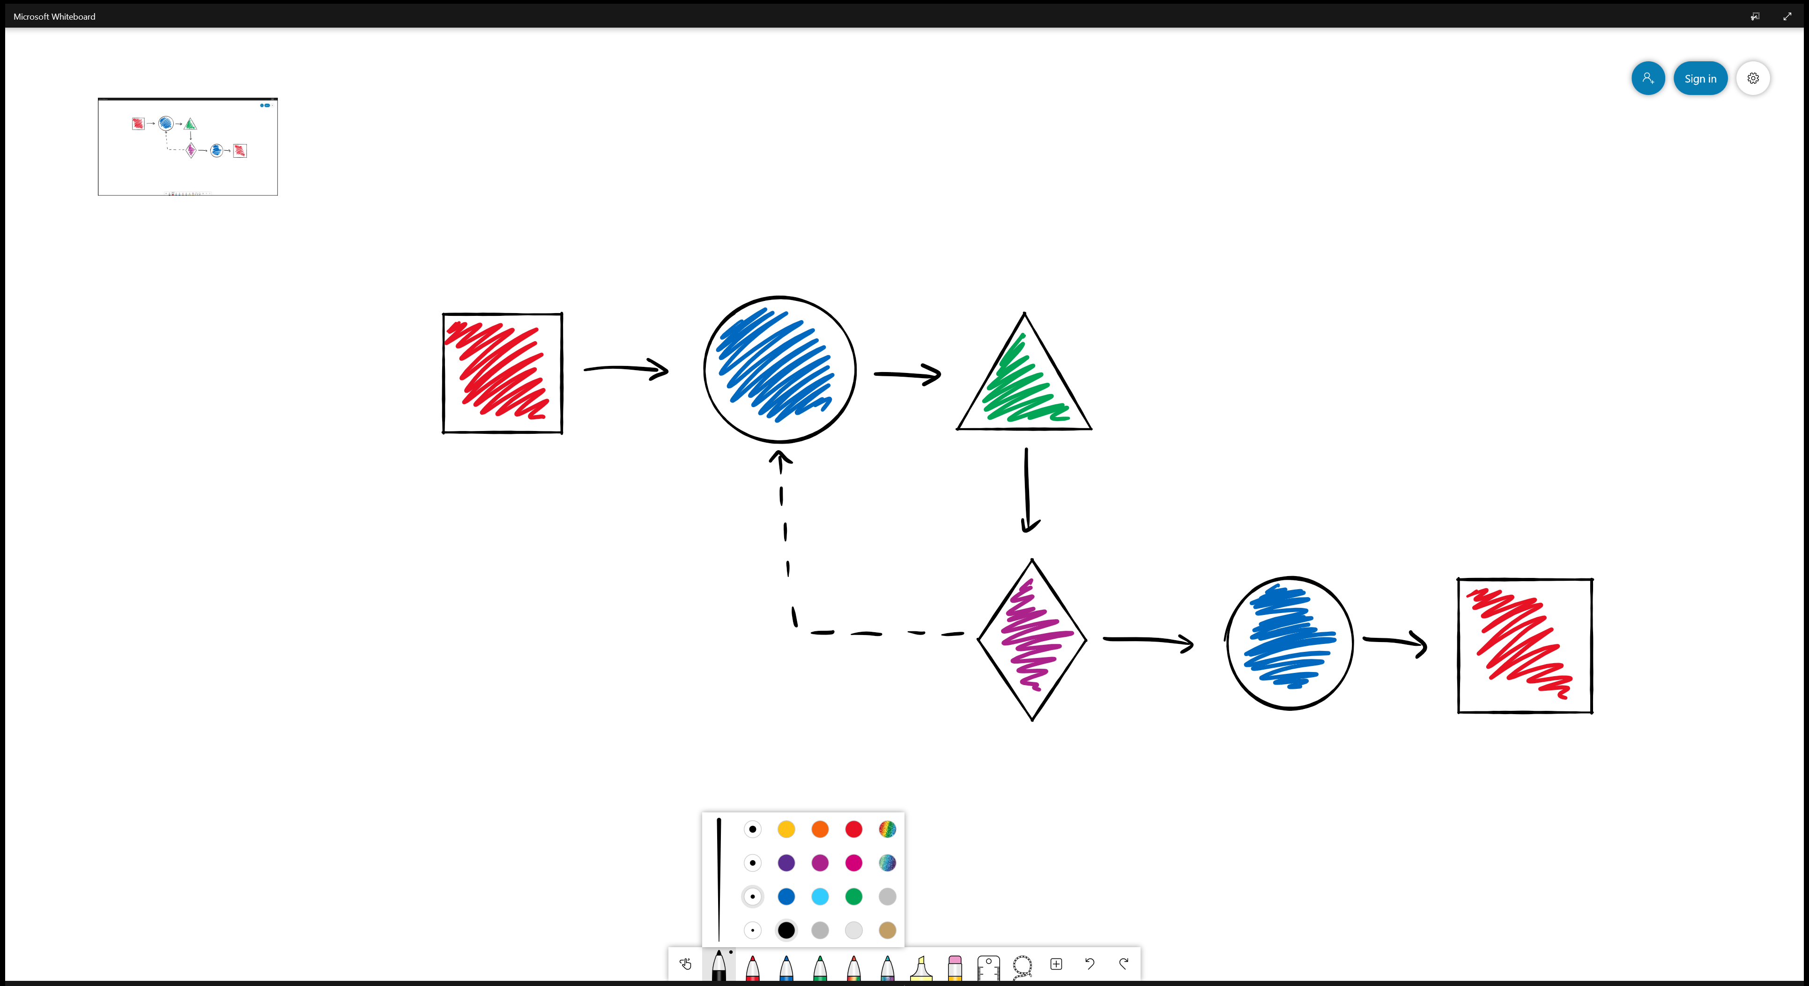
<- Back to Table of Contents

Slide 6
<- Back to Table of Contents

Slide 7
<- Back to Table of Contents

Slide 8
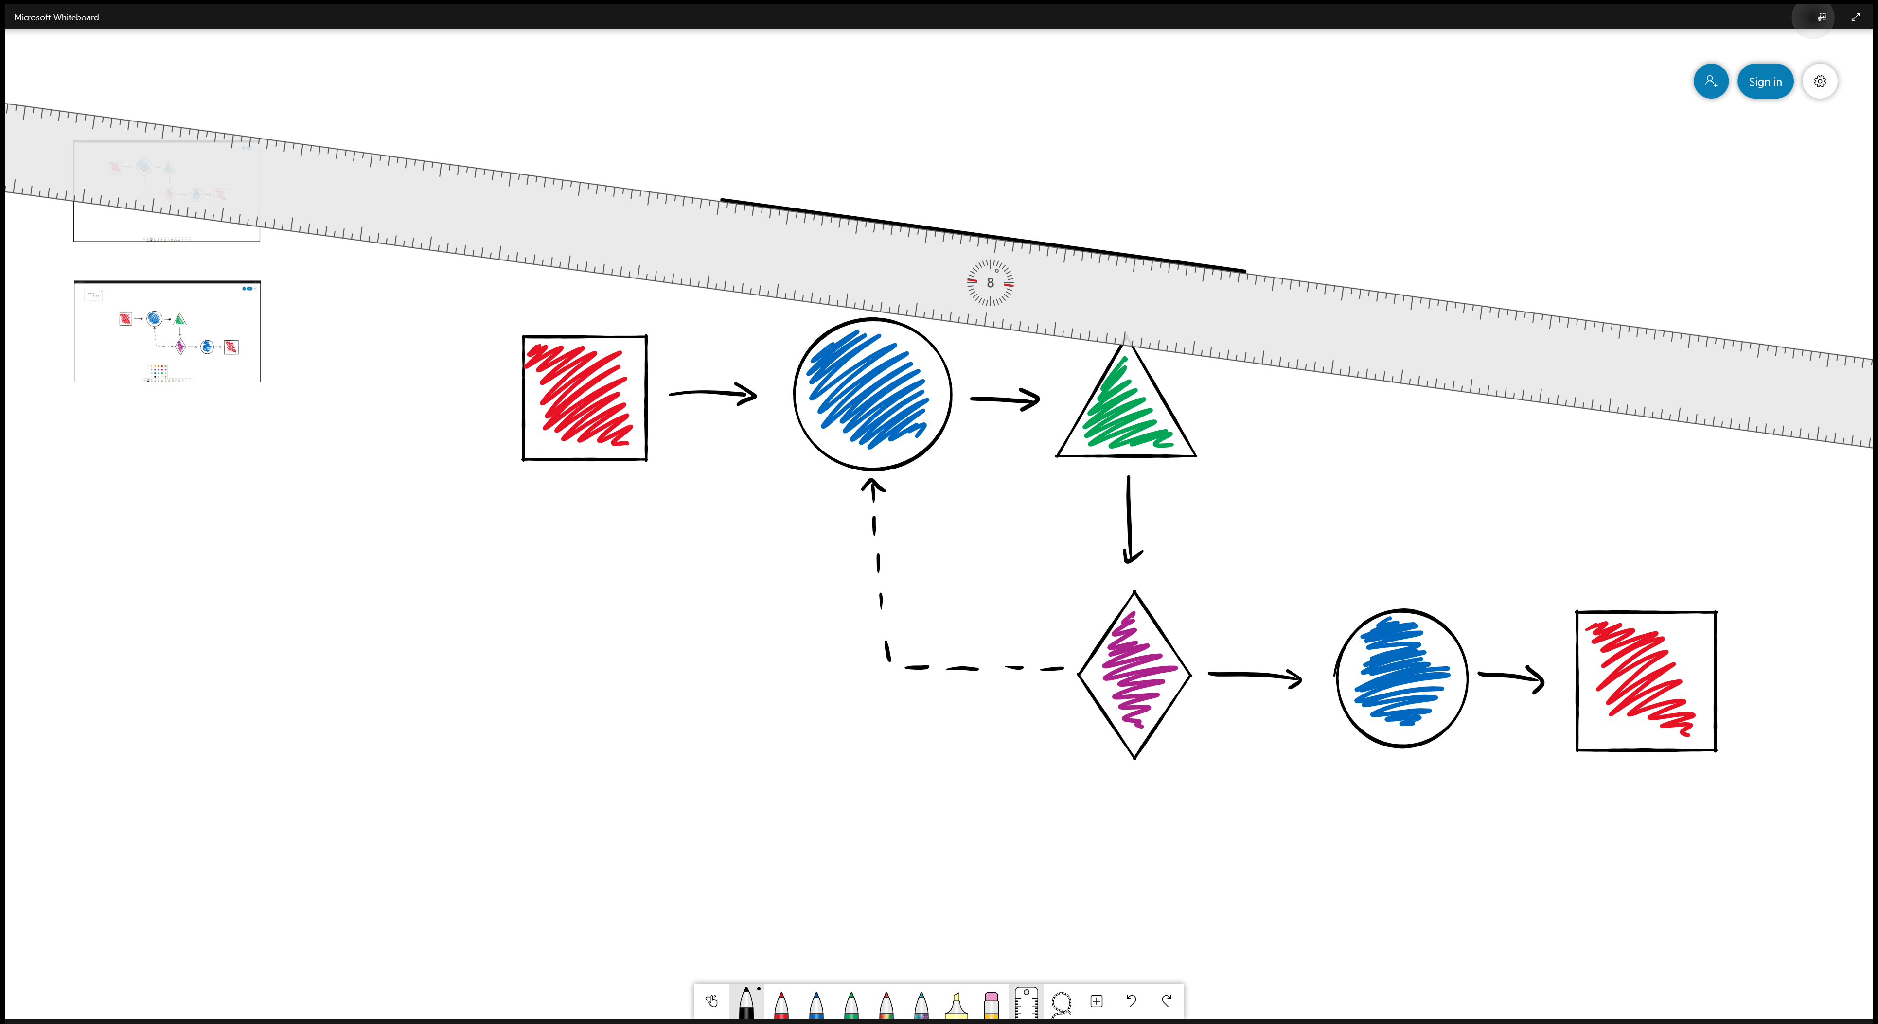
<- Back to Table of Contents

Slide 9
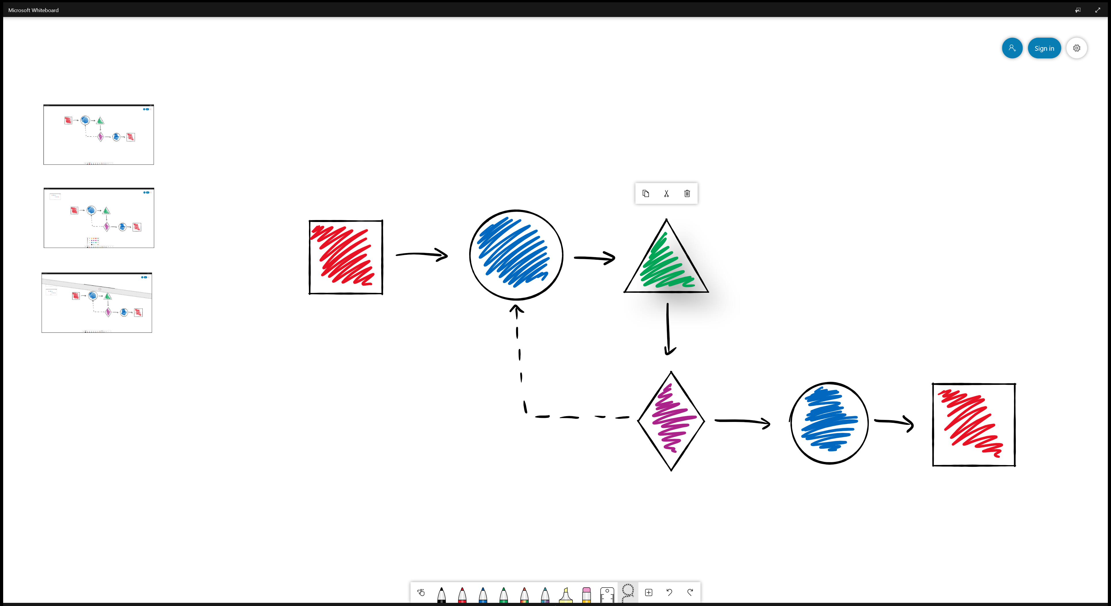
<- Back to Table of Contents

Slide 10
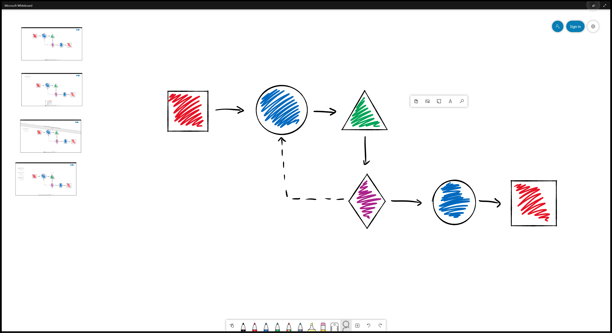
<- Back to Table of Contents

Slide 11
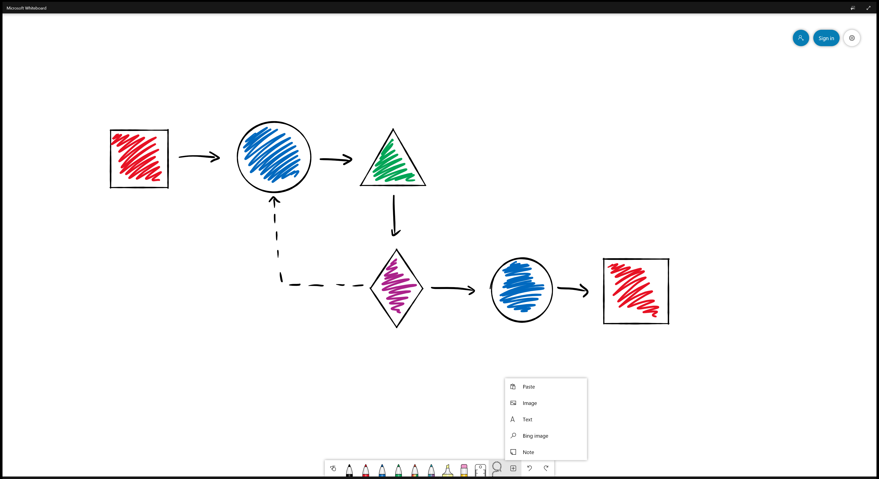
<- Back to Table of Contents

Slide 12
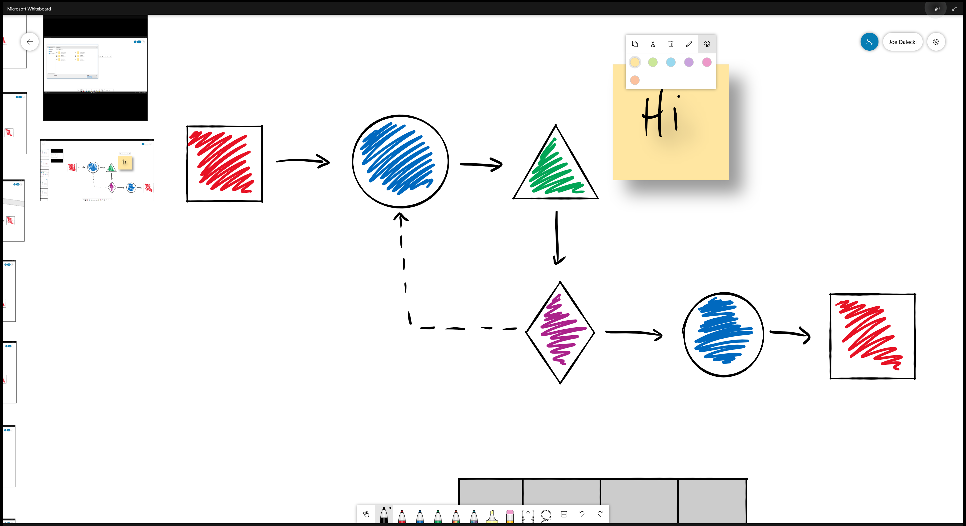
<- Back to Table of Contents

Slide 13
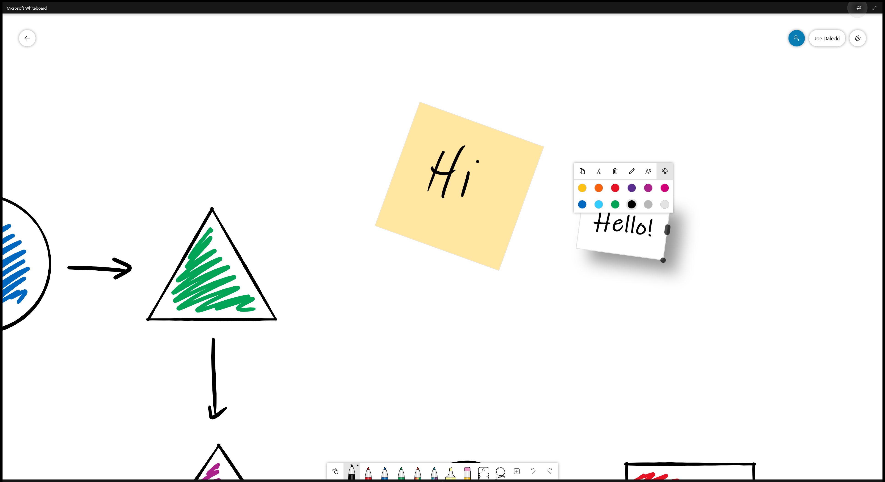
<- Back to Table of Contents

Slide 14
<- Back to Table of Contents

Slide 15
<- Back to Table of Contents

Slide 16
<- Back to Table of Contents

Slide 17
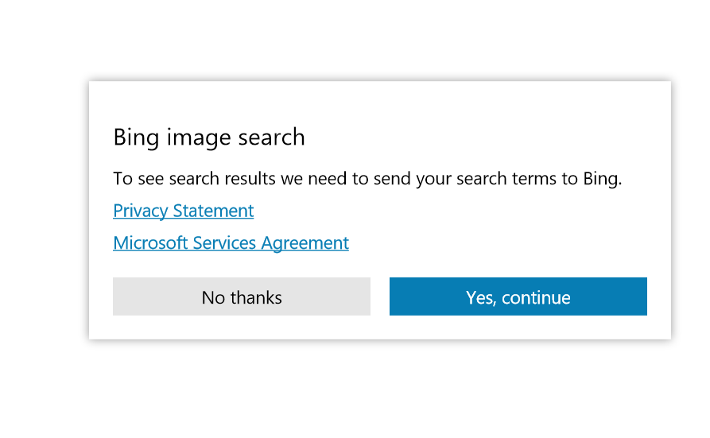
<- Back to Table of Contents

Slide 18
<- Back to Table of Contents

Slide 19
<- Back to Table of Contents

Slide 20
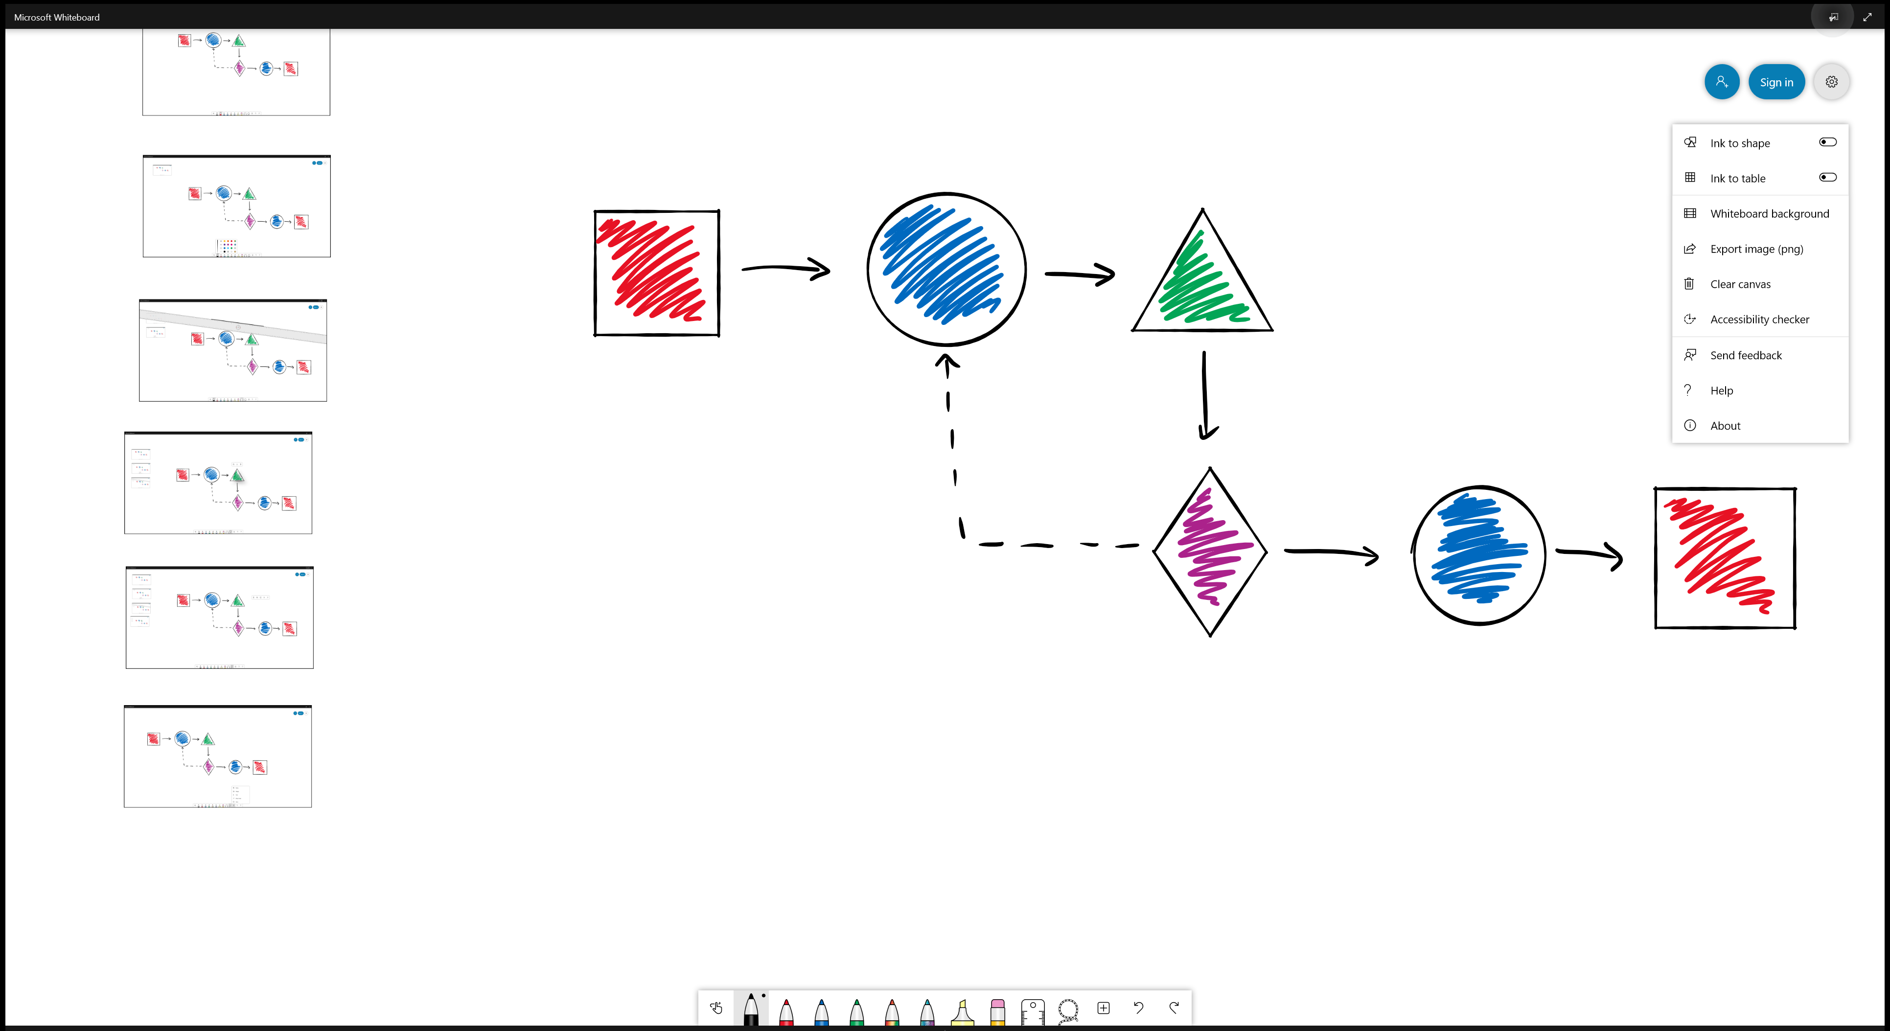
<- Back to Table of Contents

Slide 21
<- Back to Table of Contents

Slide 22
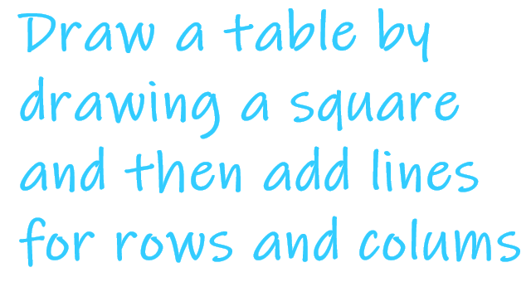
<- Back to Table of Contents

Slide 23
<- Back to Table of Contents

Slide 24
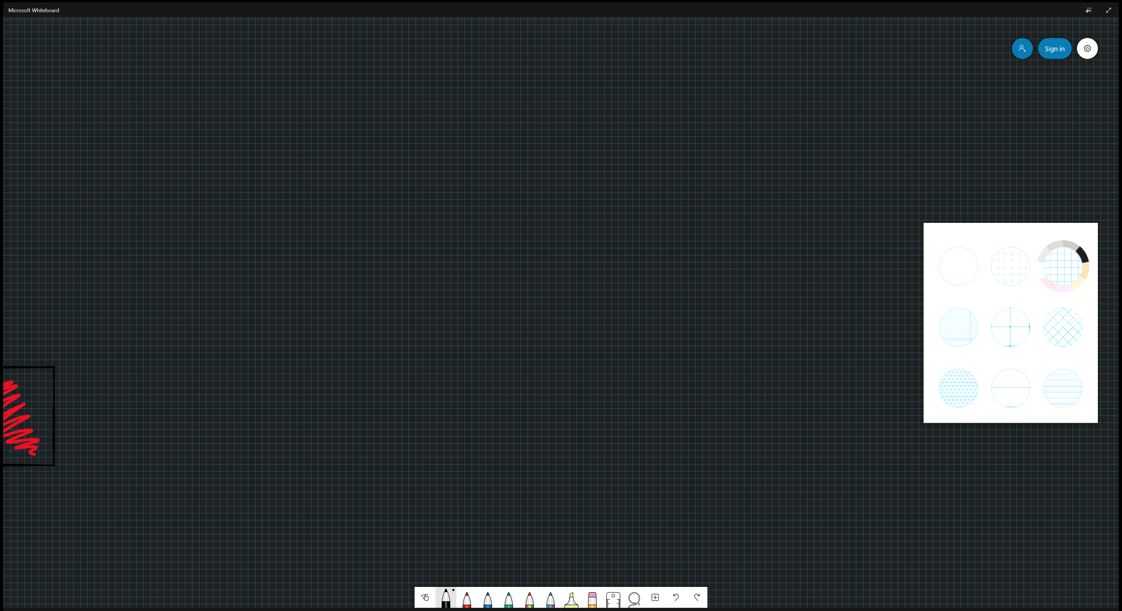
<- Back to Table of Contents

Slide 25
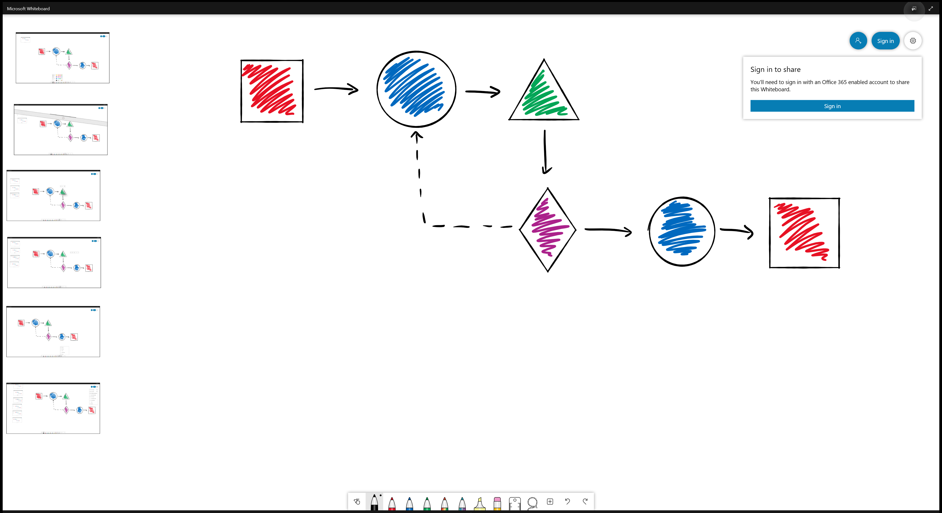
<- Back to Table of Contents

Slide 26
<- Back to Table of Contents

Slide 27
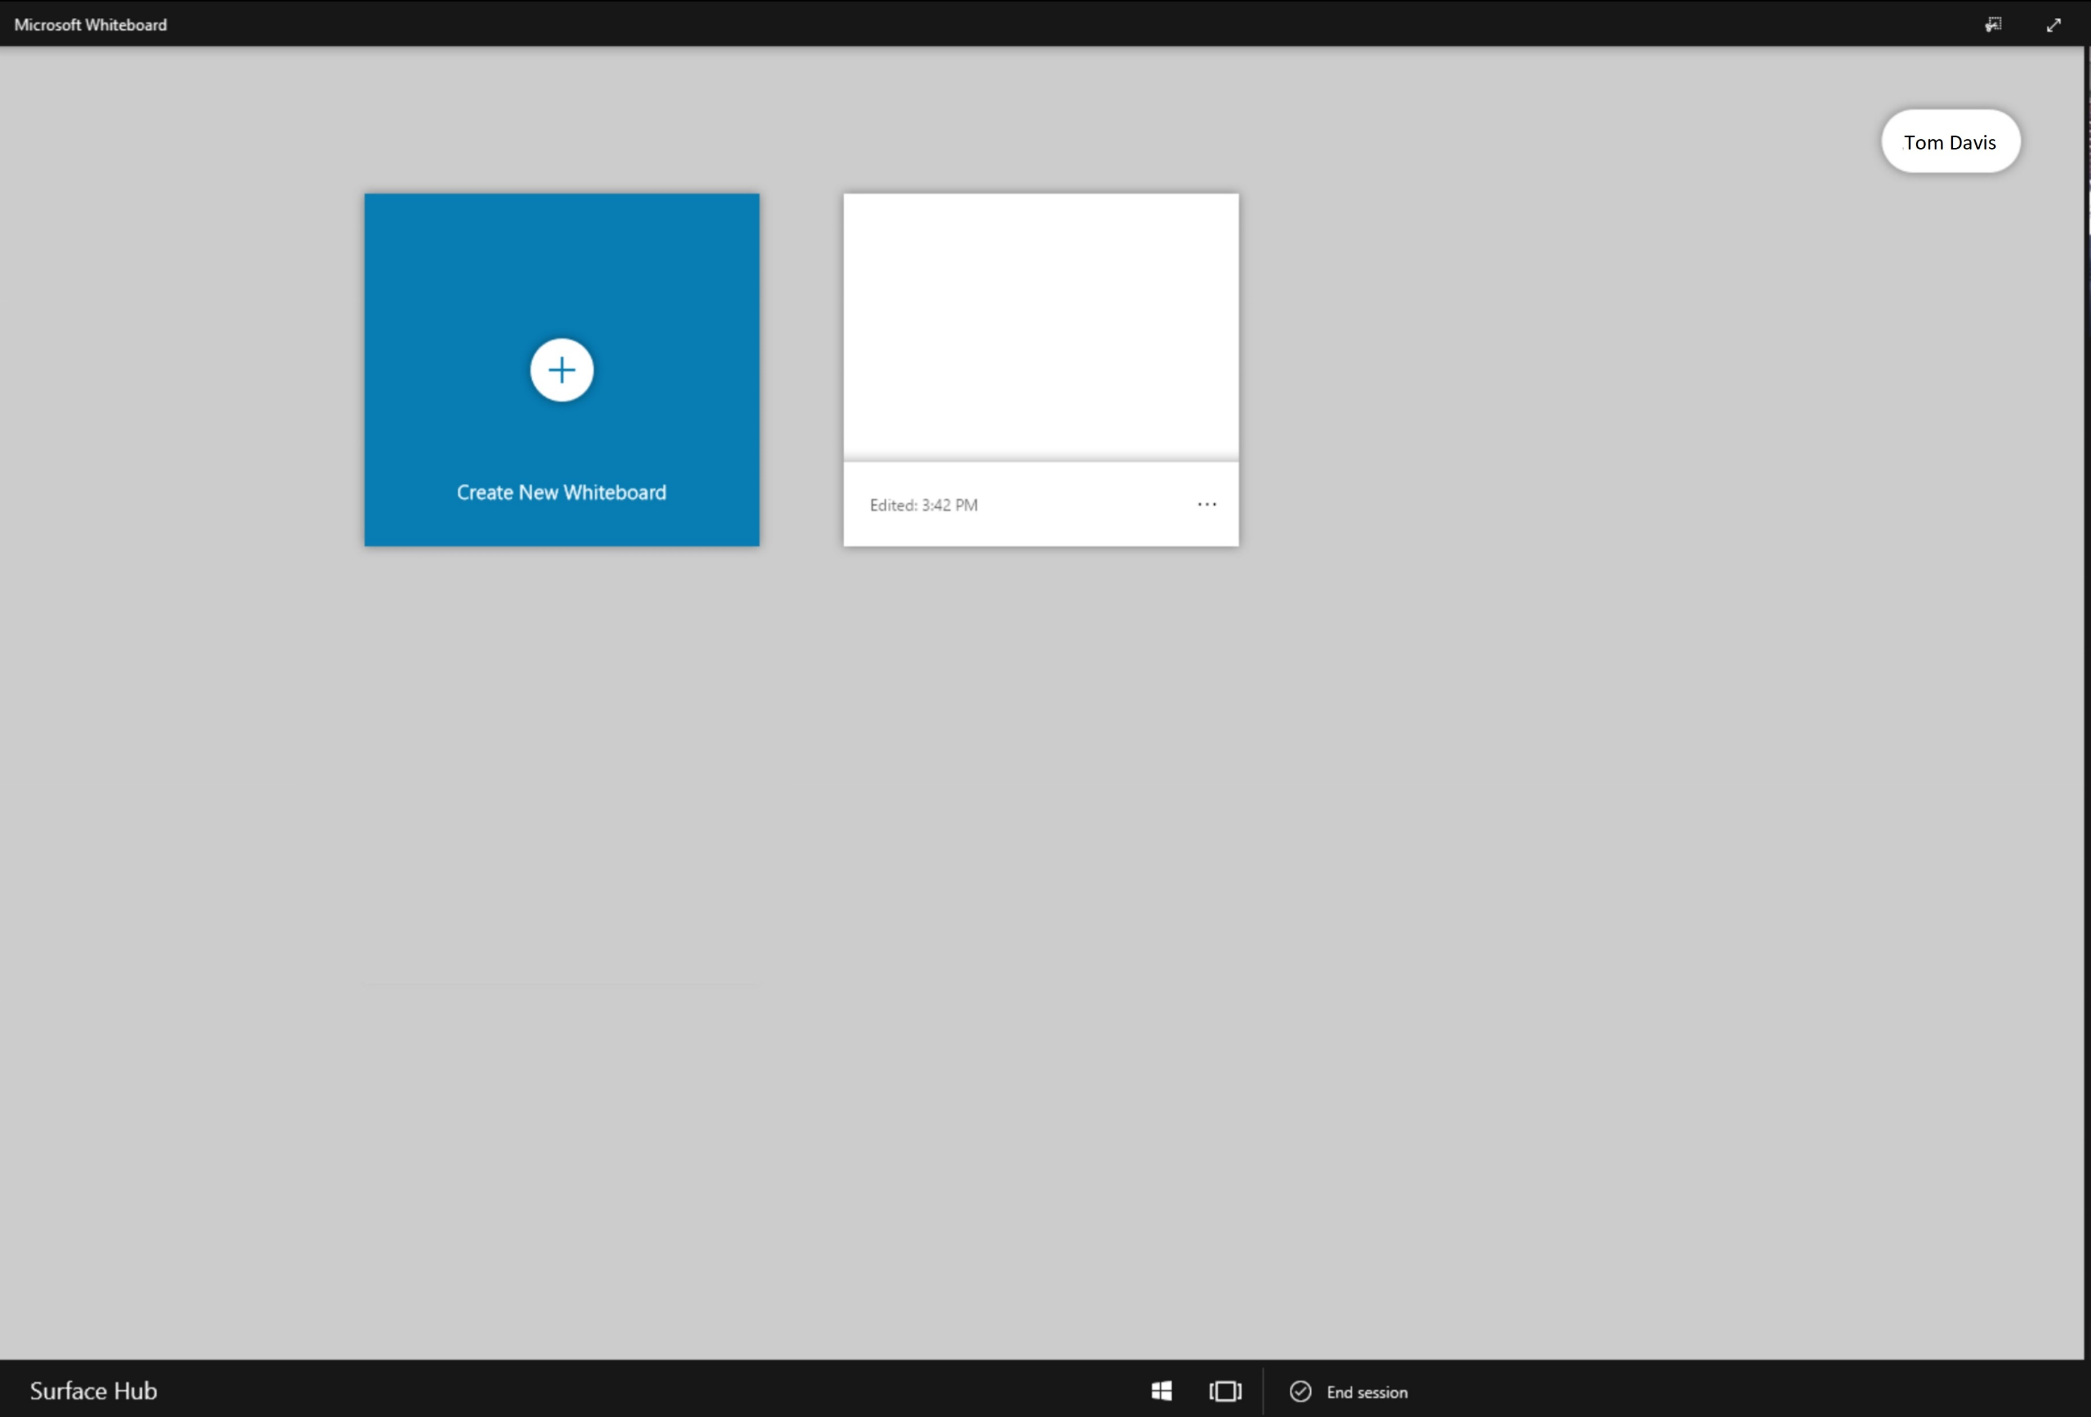
<- Back to Table of Contents

Slide 28
<- Back to Table of Contents

Slide 29
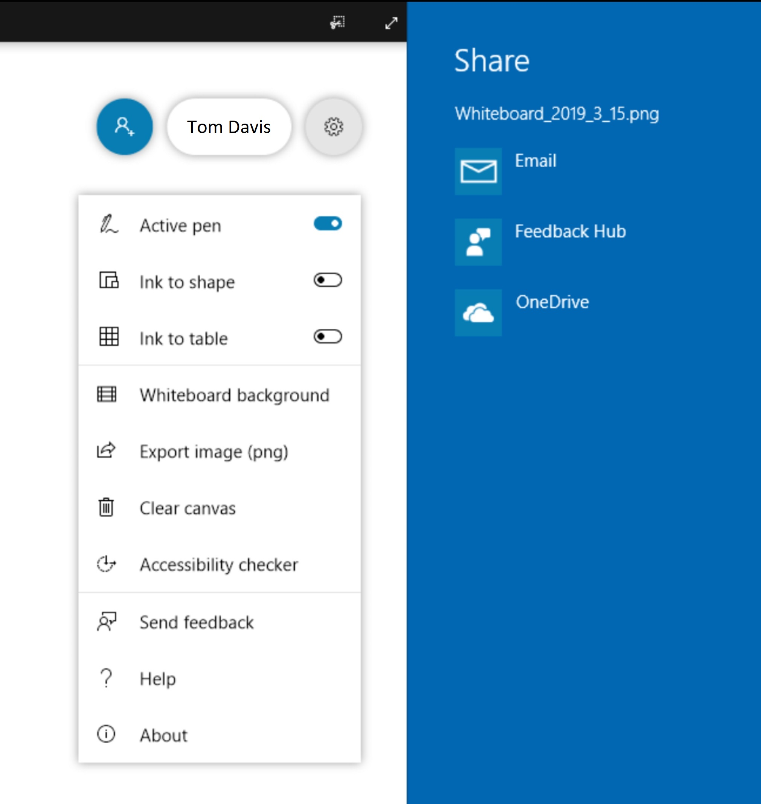
<- Back to Table of Contents

Slide 30
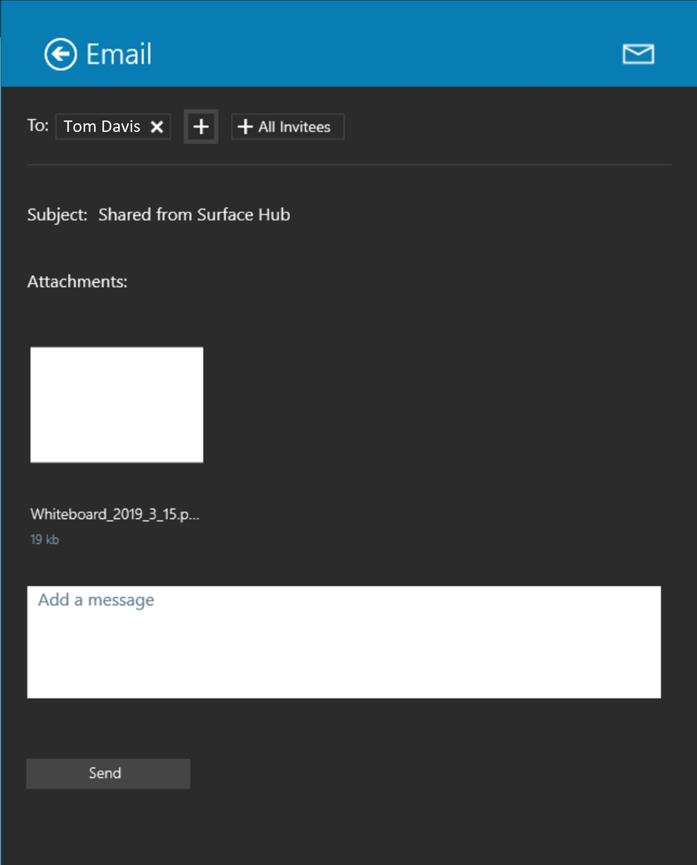
<- Back to Table of Contents

Slide 31
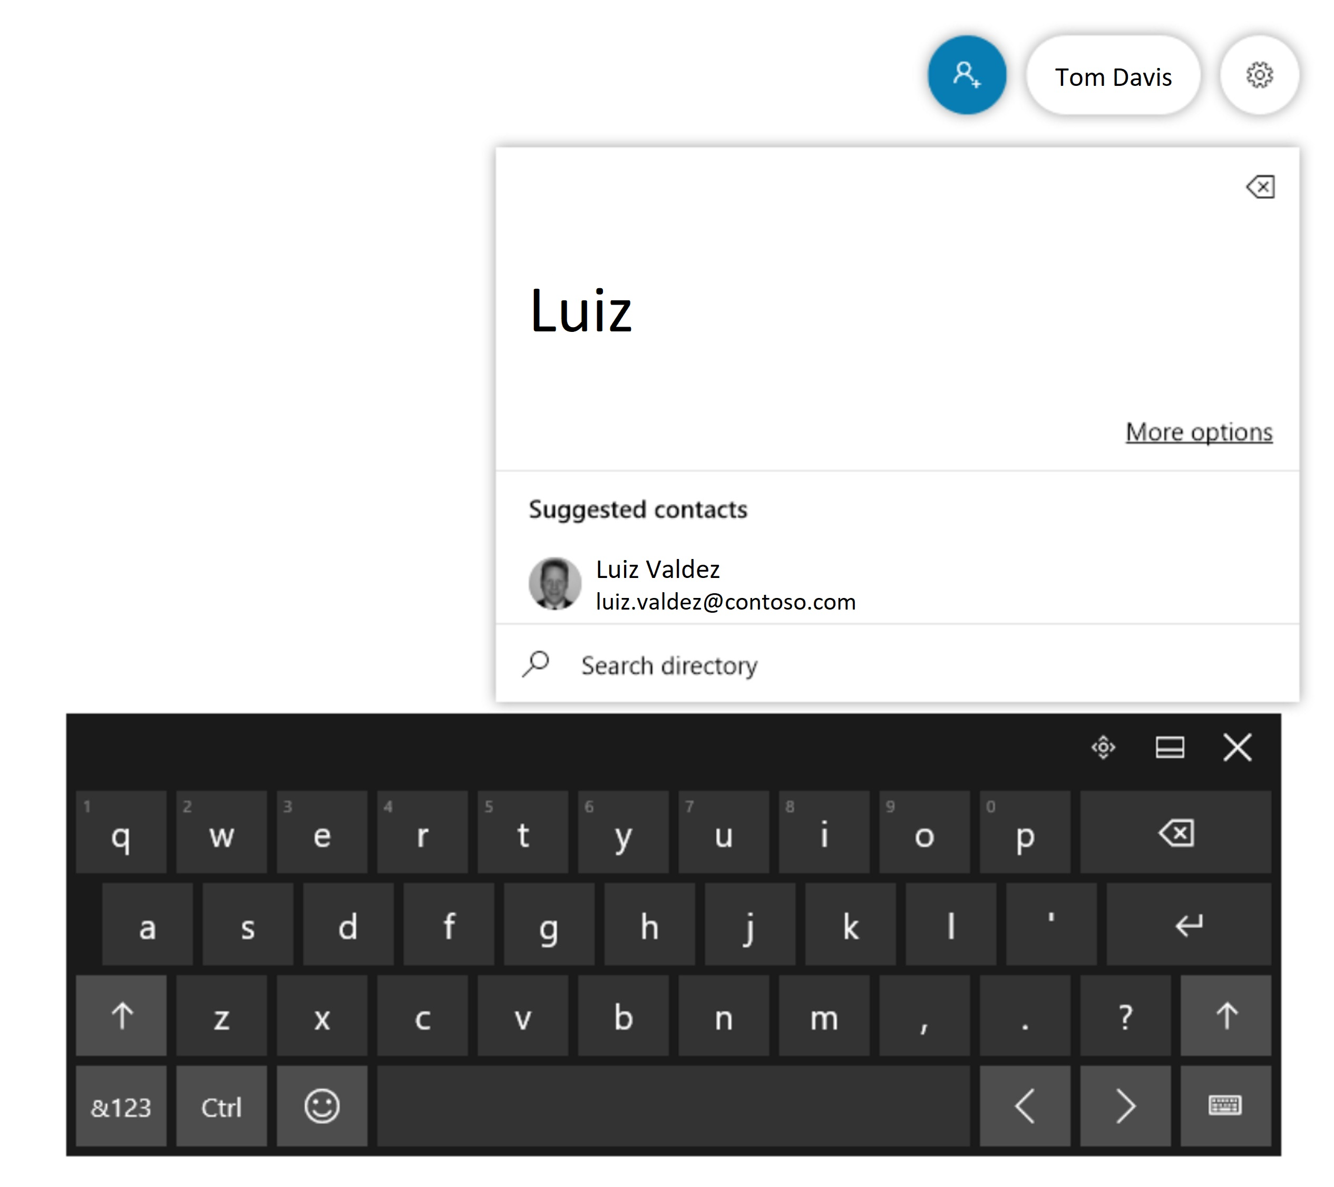
<- Back to Table of Contents

Slide 32
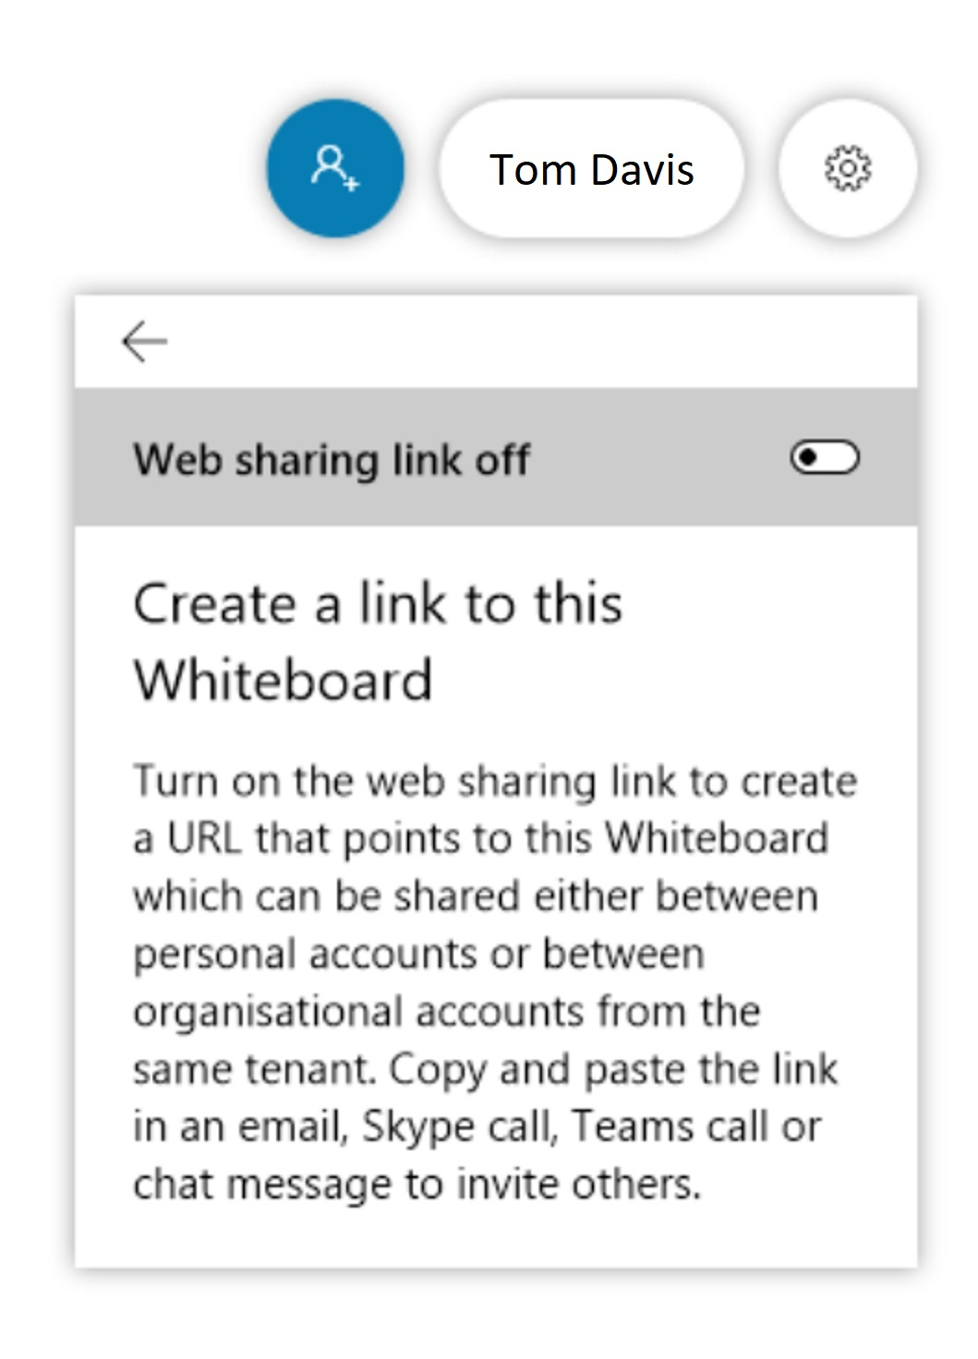
<- Back to Table of Contents

